Slide 1
BIOMASS & BIOGAS

Slide 2
Introduction:
Traditionally, biomass had been utilized through direct combustion. Cow dung cake is one of the most important and widely used biomass for the production of daily energy needs. It has been estimated that 2.5 billion people around the world are not being able to access the modern fuels. They are highly dependable on locally available wood and cow dung cakes.
About nine-tenth of the rural households in India uses traditional biomass-wood and dung-as a household fuel annually. Burning of biomass or cow dung cakes through direct combustion creates indoor air pollution and ultimately contributing to serious health problems, particularly cancer and respiratory infections.
Approximately half a million premature deaths and nearly 500 million cases of illness are estimated to occur annually as a result of exposure to smoke emissions from biomass use by households in India, making indoor pollution the third leading health risk factor.
Biogas represents renewable source of energy that derives mainly from decomposition of organic wastes in the absence of oxygen. In India, biogas mainly produced from cattle dung.
The biogas technology is being promoted by Ministry of New and Renewable Energy, Govt. of India since 1981-82.

Slide 3
Biomass:
Organic matter produced by plants. Both grown on land (terrestrial) and grown on water (aquatic) and their derivatives and animal manure. The energy obtained from biomass is called biomass energy.
Can be from of solar energy as it is used indirectly to grow these plants by photosynthesis. It is renewable source of energy because organic matter generated round the year.
Resources of biomass are as;
Biomass obtained from cultivated fields , crops, forest, algae and organism living both on land and water.
Biomass derived from wastes i.e., municipal waste, animal and human excreta, forest waste, sewage etc.
Biomass converted in to liquid fuels like methanol, ethanol etc. which can be used in eun the engines or biomass gasification. Methane gas obtained from dung and agricultural waste.

Slide 4
Photosynthesis process: biomass is produced by photosynthesis process which convert the solar energy into biomass energy. It occurs in green plants. Photosynthesis process can be represented as
6CO₂ + 6H₂O + light energy C₆H₁₂O₆ + 6O₂
Biomass includes woods waste and biogases (sugar cane refuse) which has substantial potential to generate electrical power. These are bulky & highly dispersed and contain large amount of water(50 – 90%). Not economical to transport over a long distance. However it can be converted in to liquid or gases fuels which can be easily transported and used away from their sources of produce.
Land crop:
1. Sugar crops like sugar cane and sweet sorghum.
2. Plants with soft stem which die down after flowering like herbs grass etc. called herbaceous plants.
These plants can be used for conversion in to liquid and gaseous fuels.
Estimated land crop @ 2 X 10¹² tonnes = energy potential of 3 X 10¹⁸ kJ of energy.
3. Forestry plant called sericulture plants.
Aquatic crops includes the plants grown on fresh sea water and mud water etc. e.g. algae, see weeds etc.

Slide 5
Energy conversion from Biomass
Direct combustion
Thermochemical combustion
Biochemical conversion
Direct combustion: it is in presence of oxygen / air to produce heat and by-products is called direct combustion. The complete combustion of biomass into ash is called incineration.
This heat energy in the product gases or in the form of steam can be used for various applications like space heating or cooling, power generation, process heating in industries etc.
Various designs for boilers and furnaces are available to burn biomass like woods, dung dried vegetables wastes from food industry, pulp, bagasse from sugar industries and municipal wastages etc.
The moisture content in biomass and in their wide range composition tend to produce LCV of fuel. However it biomass energy by combustion is used as cogeneration with conventional fuels, the utilisation of biomass energy makes it an attractive proposition.

Slide 6
Thermo chemical conversion: It can convert the organic biomass in to more valuable and convenient form of more products as gases and liquid fuels, residues and by-product etc. at different pressure and temperatures.
1. Gasification: Heating of biomass in presence of limited oxygen and air. It produces gases fuels like H₂, CO, CH₄ , N₂ of low calorific value.
2. Pyrolysis: It is the heating of biomass in closed vessels at temperature in the range of 500⁰ -900⁰ C in absence of oxygen / air with steam. It produces solid, liquids and gases. The pyrolysis process can use all type of organic materials including plastic and rubbers.
The gases produced by this process include the mixture of CO, CH₄ , N₂, H_{2,} CO₂ and other hydrocarbons. The liquids produced are oil like materials (acetic acid, methanol, oil and tar) and solid produced are similar to pure charcoal.

Slide 7
Biochemical conversion: The process makes use of metabolic action of microbial organism on biomass to produce liquid and gases fuels.
Fermentation of biomass & Anaerobic digestion of biomass
Fermentation : It is process of decomposing of complex molecules of organic compound under the influence of micro-organism(ferment) such as yeast, bacteria, enzymes etc.
Examples of fermentation process is the conversion of grains and sugar crops in to ethanol and CO₂ in presence of yeast. 10% of ethanol can be blended with petrol to produce gasohol. The fermentation process of sugar is carried out about 30⁰ C in acid conditions of pH value 4-5 and the completion of formation process takes about 50 hours.

Slide 8
Anaerobic digestion of biomass: Process involves the conversion of decaying wet biomass and animal wastes into biogas through decomposition process by the anaeroibic bacteria.
The anaeroibic bacteria is a micro organism that can live and grow in absence of 0₂ or air. The biogas production in anaerobic digestion depends on the types of biomass used., temperature, pH value of mixture etc.
If the production of biogas from human & animal wastage takes about 10 days at optimum temperature of 35⁰ C while decomposition of biomass like sewage sludge, green plant etc. takes longer time. The gas mixture of methane (55 – 70%) and reminder is CO₂ with other impurities.
The most useful biomass for production of biogas are animal and human waste, algae, hyacinth, plant residue and other organic waste materials with high moisture content.

Slide 9
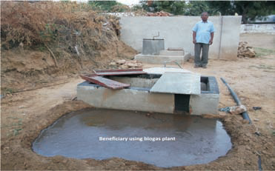
BIOGAS GENERATION:
Biogas is generated by the activity of anaerobic bacteria.
Biogas is comprised of about 60% of methane, 40% of carbon dioxide, and small amount of hydrogen sulfide, nitrogen, ammonia, hydrogen & moisture.
The heating value of biogas is about 60% of natural gas and about 25% of propane.
Biogas has corrosive nature and storage of biogas is not practical.
Organic material is something that was living and can decay. Wasted or spoiled food, plant clippings, animal manure, meat trimmings and sewage are common types of organic material used with anaerobic digestion.
In contrast, inorganic material includes things like rocks, dirt, plastic, metal and glass.

Slide 10
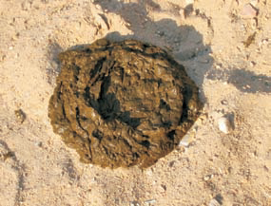
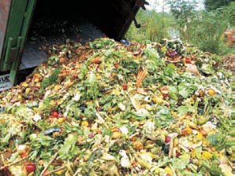
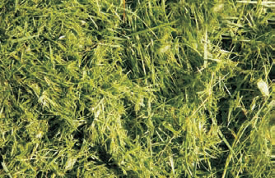
BIOGAS GENERATION SOURCES
Commonly made from animal slurry, sludge settled from wastewater and at landfills containing organic wastes.
From almost any organic waste has the ability to produce biogas: human excreta, slurry, animal slurry, fruit and vegetable waste, slaughterhouse waste, meat packing waste, dairy factory waste, brewery and distillery waste, etc.
Many wastewaters contain organic compounds that may be converted to biogas including municipal wastewater, food processing wastewater and many industrial wastewaters. Solid and semi-solid materials that include plant or animal matter can be converted to biogas.
Cattle dung
Kitchen waste
Agriculture wastage

Slide 11
Principles of biogas production:
Organic matter anaerobic decomposed in the presence of bacteria. The bacterial decomposition of organic matter takes place in three phases e.g. Hydrolysis, Acid phase and Methane phase.
Hydrolysis: Biomass having complex compounds like fats, proteins, carbohydrates are broken into simple water soluble organic compounds through influence of water.
Acid formation: Microorganism of anaerobic & facultative group produce mainly the acetic acid and propanoic acid at low temperature of 25⁰ C with release of CO₂. certain case producing large quantity of acid which biological activity arrested thus it need to maintain the pH value of mixture.
Methane formation: Anaerobic bacteria called methane formers converts the organic acids formed in second stage in to biogas having main constitutes as methane and CO₂ with other small traces of H₂S, H₂, N₂ etc. these methane formers are sensitive to pH changes.

Slide 12
Advantages of biogas plant
It provides clean gaseous fuel for cooking and lighting.
Digested slurry from biogas plants is used as enriched bio-manure to supplement the use of chemical fertilizers or as animal feed or fuel after drying.
The biogas after removal of CO2 produce an excellent fuel as CH₄ gas. It can be used for cooking, lighting, running diesel engines, fuel for furnace.
Sewage waste after biogas production is converted into less offensive slurry and almost free from pathogens It improves sanitation in villages and semi -urban areas by linking sanitary toilets with biogas plants.
Biogas plants help in reducing the causes of climate change.
Gas production is cheap.

Slide 13
Factors affecting the production of biogas
Temperature and pressure: 25⁰ C -55⁰ C & 1.1 -1.2 bar absolute , if temperature increases the rate of production increases but CH₄ % decreases. Optimum range of temperature is 35⁰ C - 40⁰ C.
If temp. are lower than 20⁰ C , rate of gas production falls sharply and it almost cease at @10⁰ C, thus in cold countries it need to heat digester to @ 35⁰ C.
Solid concentration and loading rate: Recommended proportions are Cow dung + solid waste 1:1 by weight and forming to about 10% of solid content and 90% water.
Feed supply per day to the digester is called loading rate. The recommended loading rate are about 0.2 kg/m³ of digester capacity. Under & over loadings are reduces the biogas production.
The loading of feed must be carried out every day at the same time so as to keep the solid concentration ratio constant in the digester.
Retention period: It is time period for fermentable material remains inside the digester. Period ranges 35 -50 days depends on climatic condition and locations.
Longer retention period need larger size digester and allows more complete digestions of feed.

Slide 14
PH value: Hydrogen ion concentration is recommended 7-8 for biogas formations.
Nutrient compositions: major nutrients required by bacteria in digester are N₂, P, C, H₂, O₂ to accelerate anaerobic rate.
Carbon in carbohydrates supplies the energy and nitrogen in proteins needed for building of growth of bacteria C:N ratio need to be supplied in the 30:1 with 2% prosperous for maximum biological activity. Oil cakes and animal urines are found suitable nutrients for this purpose.
Toxic substance: presence of ammonia, pesticides, detergents, heavy metals are considered as toxic substance to micro – organism since their presence reduces the fermentation rate. Also digest slurry if allowed to remain in digester beyond certain time., it becomes toxic to micro-organism growth.
Digester size and shape: biogas production per unit volume of digester is high when diameter to depth ratio ranges between 0.66 to 1.
Stirring agitation of the content of digester: occasional mixing allows the mass float at the top in the form of scum allows to mix with deposited at the bottom. It help in improving the fermentation process.

Slide 15
Classification of Biogas plant
Continuous or batch type
Dome & drum type
Continuous or batch type: (a) Single stage (b) Two stage biogas plants
Single stage biogas plant: Entire process of conversion of biomass in to biogas (acid formation & methane formation) are carried out in a single chamber or digester without barrier. Such plant are simple in construction, easy to operate and control. No need skilled worker.
Two stage biogas plants: plant have two separate chambers for digestion of biomass. Firs stage acid formation take place . Then the dilute acids are only fed into second stage where methane formation is carried out. Biogas is collected from the second chamber.
Advantages:-It produce more biogas, require small size of digestion chamber and less period of digestion as compared to single stage plants.
Disadvantages:- digestion is complex, plant is costlier, difficult to operate and maintain, requires skilled manpower. Size of plants is large.

Slide 16
Batch type biogas plants:- biomass feeding is done in batches with large time interval between two consecutive batches.
Digester is loaded with feed and given sufficient time (30-45 days) for digestion of biomass. After completion of digestion, the residue is emptied and it is again charged with next batch of feed.
Silent features: gas production is intermittent & unevenly paced.
Need several digesters for continuous supply of gas.
Cost & space requirement is high.
Need additional fermentation slurry to start anaerobic fermentation.
Plants have longer digestion period, thus they are suitable for hard fibrous materials.
Have operational & maintenance problems.

Slide 17
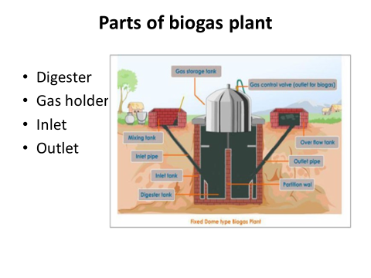
Dome & drum type biogas plants:
Floating drum type biogas plants: Khadi and Village Industries commissions (KVIC) suitable for small scale gas production.
Consist of an underground digester made of masonry construction in the form of well bellow the ground level and a moving gas-holder called as dome made of mild steel.
Gas-holder floats either directly on the fermentation slurry or in a separate water jacket.
The gas is collected in the gas drum, which rises or moves down, according to the amount of gas stored.
Inlet tank animal waste slurry is prepared containing cow dung and water, ratio of 1:1.25. the feeding of animal waste slurry is done one in a day.
Sludge is excellent fertilizer which can be again feed to soil. The accumulated gas is collected at top & drawn through valve and outlet pipe.
Bifurcation of digestion chamber through partition wall provides optimum conditions for growth of acid former & methane former as the pH value requirement for these bacteria are different.
This gives a good yields of biogas. It operate under constant pressure.
Diameter of plant is 1.2 – 6 m. and high varies from 3-6m.FRP material used for gas holder, however it is costly.

Slide 18
Inlet chamber
To supply cow dung to the digester.
It is made at the ground level so that the cow dung can be poured easily.
Made up of bricks, cement and sand.
The outlet wall of the inlet chamber is made inclined so that the cow dung easily flows to the digester.

Slide 19
Digester
Most important part of biogas plant.
Fermentation takes place - fermentation tank.
Built underground – insulated, airtight
Made up of bricks, sand and cement.
Almost at the middle of the height of digester, two openings are provided on the opposite sides for inflow of fresh cow dung and outflow of used cow dung

Slide 20
Gas holder
Cylindrical container
Above digester
Collect gas
The gas pipe carries the biogas to the place where it is consumed.

Slide 21
Outlet Chamber
Digested slurry from which the biogas has been generated is removed from the biogas plant.
The outlet chamber is also at the ground level.

Slide 22
Advantages:
High gas yield
No problems of gas leakages
Work under constant pressure naturally
No problem of mixing of biogas with external air, thus no danger of explosion.
Disadvantages:
Higher cost
Heat is lost through metal gas holder
Requires painting of drum to avoid corrosion at least twice in a year.
Requires maintenance of pipes and joints.

Slide 23
Fixed dome type biogas plants: Digester & gas dome are enclosed in same chamber. Best for batch type. More economical then the floating dome type. It need masonry work for construction. Digester built below ground level. Suitable for cold climate.
Pressure inside dome varies depending upon the rate of production and its consumption. However total volume of gas constant thus known as constant volume type biogas plants.
Janta model: It is similar to KVIC model except both the digester & gas holder are constructed in fixed dome usually below the ground level. Mixture of biomass & water is supplied as feed to the digester through inlet pipe. Biogas generated in tank by anaerobic digestion is collected in upper part of digester.
Biogas is delivered via outlet gas pipe. When gas produced, the liquid level in digester drops where level in displacement tank rise. The high difference between two levels helps in regulating pressure (above atmosphere)of gas within digester.
Due to under ground construction, temperature remain constant and unaffected to environment, So suitable for winter operation.

Slide 24
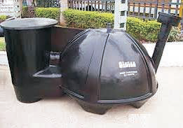
Flexible bag type biogas plant:
Digester is made of flexible plastic material. Biomass with water and biomass slurry is supplied to digester from inlet pipe.
After anaerobic digestion the biogas is collected in the upper part of the bag like dome of digester which gets inflated. The digested slurry is discharged from outlet pipe.
Flexible bag type biogas plant

Slide 25
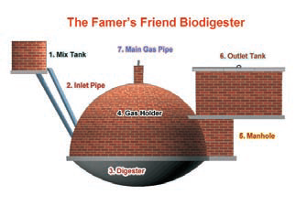
Deenbandhu biogas plant: Developed by action for Food Production (AFPRO), New Delhi in 1984.
Slurry of cow dung and water is made in the mixing tank and feed into the digester through inlet pipe. The digester is curved at bottom and hemispherical shape at top.
The anaerobic digestion of biomass slurry produces the biogas and it is collected in the upper portion of dome. Gas pressure causes the digested slurry to move out to the displacement chamber.
Advantages:
- Plant cost is less compared to floating drum type.
- Loss of heat is negligible due to under ground construction.
- No corrosion problems as in fixed drum
- It is maintenance free.
Disadvantages:
Need skilled labor operate
Gas production /m3 of digester volume is less
Gas is produced at variable pressure

Slide 26
Site selection for biogas
Should have minimum distance between the points of gas production and gas consumptions.
Should be constructed in open space to utilization sun energy since the biogas production is high above 25⁰ C temperature.
It should be constructed at least 10 m away from wells to avoid seepage of fermented slurry.
Sufficient quantity of water along with biomass is availbale at site for formation of biomass slurry.
Sufficient space is available for its operation and maintenance.

Slide 27
Safety measurement for floating drum type biogas plant:
It is essential that all the air in the gas holder is released to environment whenever the holder is removed for cleaning, painting and any other purpose.
Do not weld the gas holder when it full of gas.
Corrosion of the gas holder should be avoided by water jacket seal.
Safety measurement for fixed dome type biogas plan:
The main gas outlet valve at the top of the dome must be kept open while feeding dung slurry into the plant for the first time after installation or during the cleaning of the plant.
Gas must not be lighted at the main valve on the top of the dome. Otherwise sometimes due to negative pressure or back fire, explosion can take place resulting in damage to the dome and other part of the plant.
Inlet and outlet chambers should be covered firmly with stone or concrete slab to prevent children or animals falling in accidently.

Slide 28
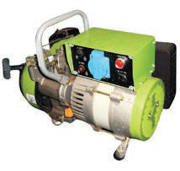
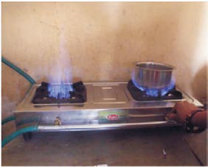
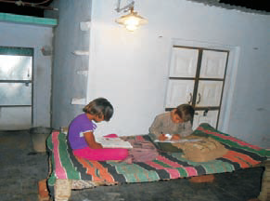
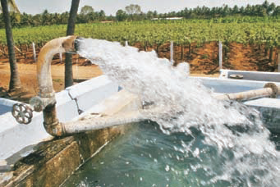
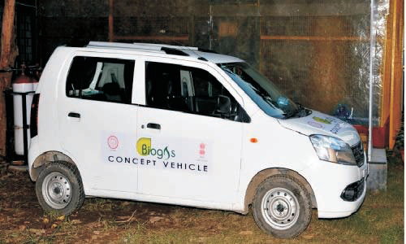
Major applications of biogas plant
One cubic biogas - 4-5 kWh electricity
Cooking 0.25m3/person/day
Lighting 0.13 m3/hour/lamp
Engine operation 0.5 m3/hour/horse power
Bio - CNG means methane gas derived from organic material. It is identical in properties to natural gas, but it is not derived from fossil fuels.
Bio - CNG can be produced from biogas which has been cleaned or upgraded to meet natural gas specifications, by the removal of gases such as CO and hydrogen sulphide to leave 2 an almost pure (90 - 98%) methane gas.

